Slide 1
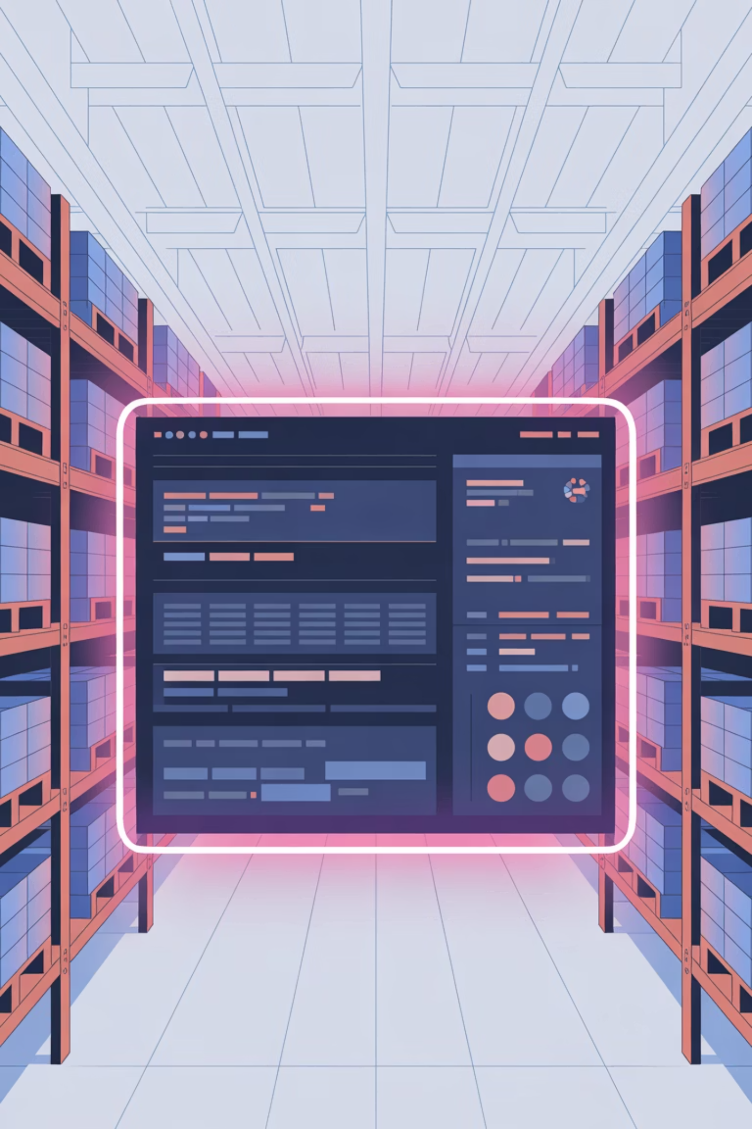
Tile Warehouse Management System
Full Stack Web Application
Technologies
React, Spring Boot, Docker
Presented By
Thangam K 23suca24

Slide 2
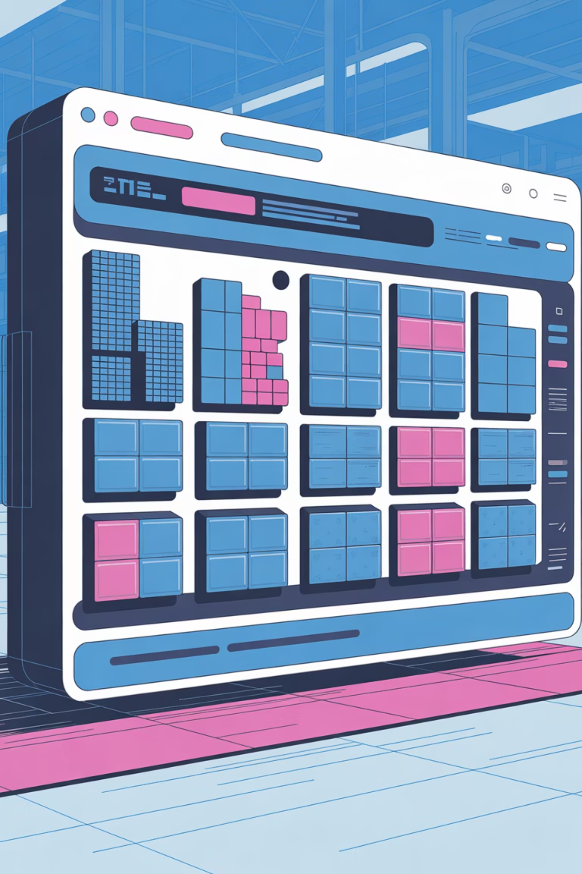

Project Overview: Streamlining Tile Inventory
The Tile Warehouse Management System is a comprehensive full-stack web application designed to revolutionise tile inventory management. It provides robust Create, Read, Update, and Delete (CRUD) operations, ensuring accurate and up-to-date inventory records.
1
2
Frontend
Backend
Built with React for a dynamic user experience.
Developed using Spring Boot, ensuring powerful server-side logic.
3
Containerisation
Backend services are containerised with Docker for seamless deployment.

Slide 3

The Challenge: Manual Inventory Inefficiencies
Traditional, manual approaches to tile inventory management are fraught with inefficiencies, leading to significant operational hurdles for warehouses.
Operational Bottlenecks
Data Discrepancies
Outdated Systems
Manual processes are slow, resource-intensive, and prone to human error, hindering timely inventory updates.
Lack of a centralised system results in inconsistent data across various records, making accurate stock tracking nearly impossible.
Existing methods often fail to meet the demands of modern warehouse operations, necessitating a robust, web-based solution.

Slide 4
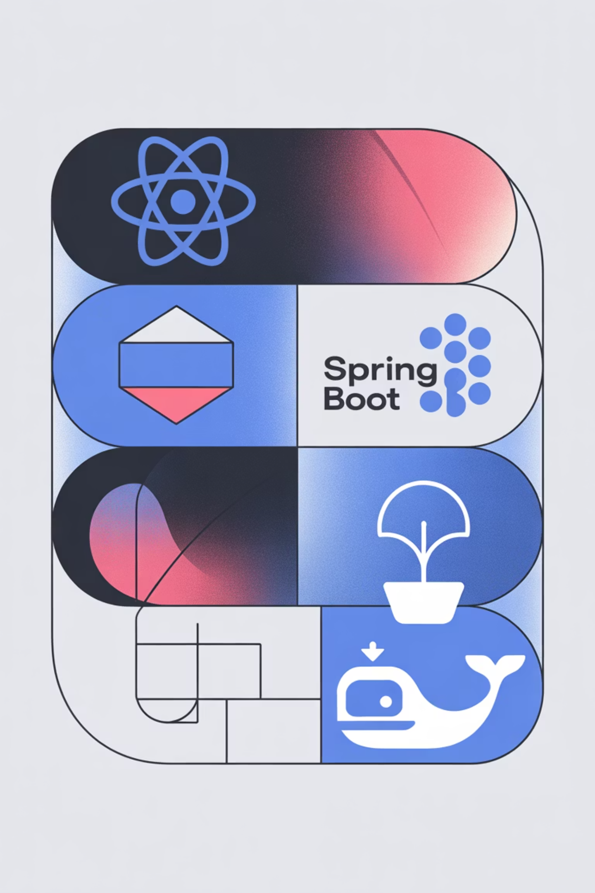
Our Solution: A Modern Web-Based System
Our solution delivers a sophisticated, full-stack web application designed to overcome the challenges of manual inventory management. This system leverages cutting-edge technologies to provide a seamless and efficient user experience.
1
Interactive Frontend
A dynamic React-based interface ensures intuitive user interaction and real-time inventory updates.
2
Robust Backend API
A Spring Boot REST API handles all data processing and business logic, providing a reliable foundation.
Docker Containerisation
3
The backend is fully containerised using Docker, guaranteeing portability and consistent deployment across environments.
Seamless Integration
4
Frontend and backend communicate effortlessly via REST APIs, creating a cohesive and responsive application.

Slide 5
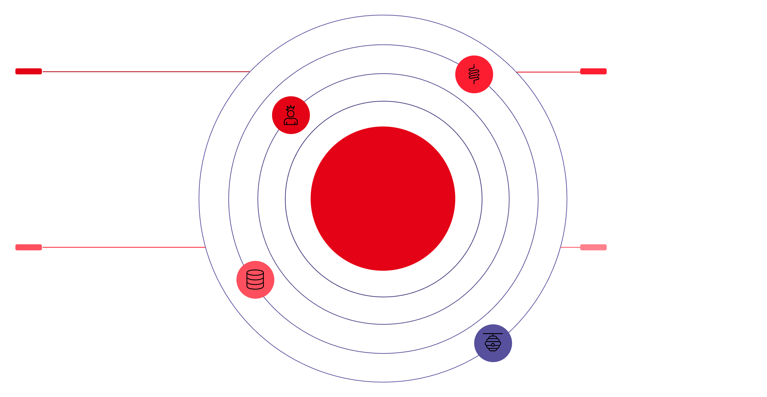

System Architecture
React Frontend
Spring Boot Backend
Vercel deployment serving UI
Docker container on localhost:8080
Tile Warehouse System Architecture
H2 In-Memory DB
REST API
Lightweight runtime storage for tests
HTTP communication between layers
This architecture diagram illustrates the distinct layers of our Tile Warehouse Management System, showcasing how each component interacts to deliver a functional and scalable solution. The separation of concerns ensures maintainability and flexibility.

Slide 6
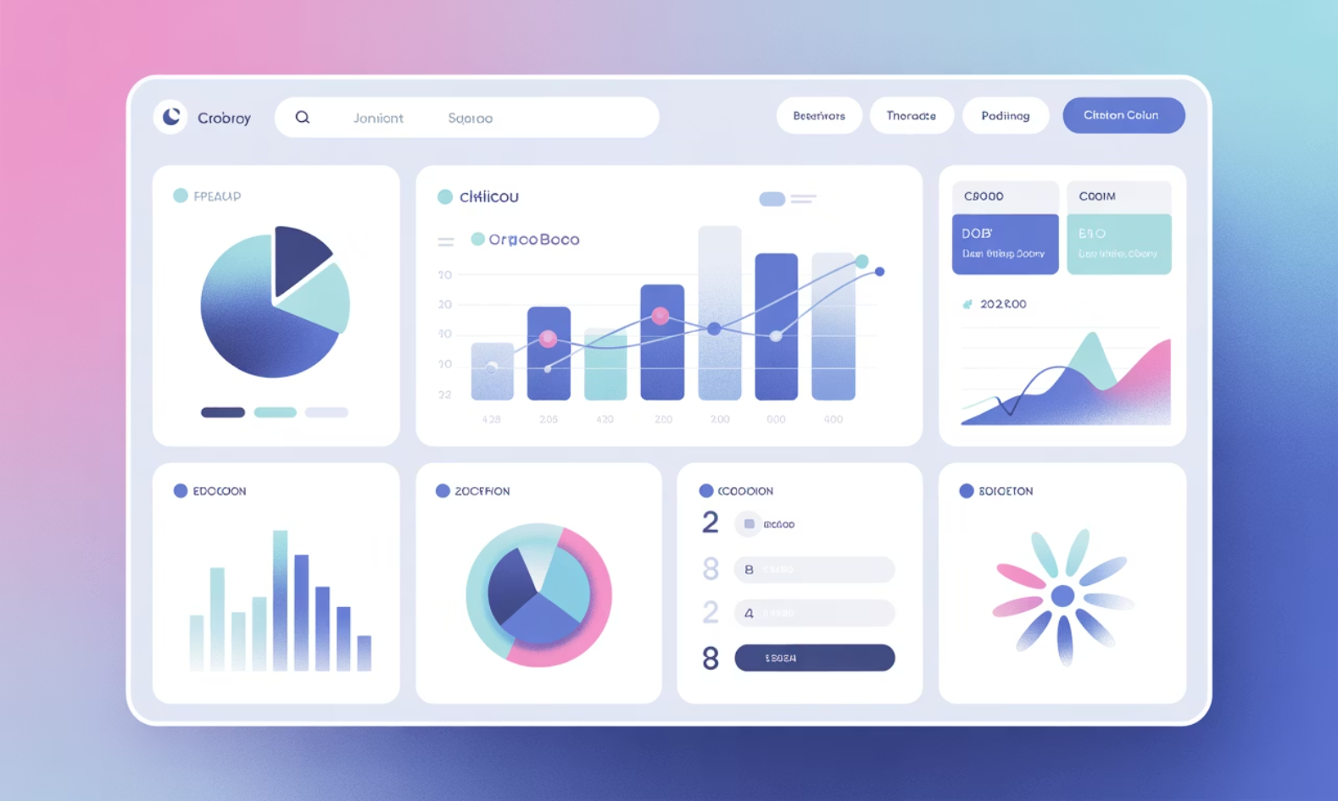
Frontend Module: React and Vercel
The frontend module serves as the primary interface for users, offering a rich and intuitive experience for managing tile inventory.
Key Features
View existing tiles with detailed information.
Add new tile entries to the inventory.
Update details for existing tiles.
Delete tiles from the system.
Live URL: tiles-warehouse-frontend.vercel.app/
Built with React
Vercel Deployment
Leverages React's component-based architecture for a highly modular and maintainable user interface.
Deployed on Vercel for fast, reliable, and scalable hosting, ensuring global accessibility.

Slide 7



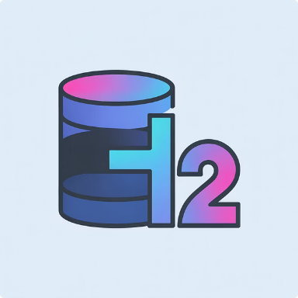

Backend Module: Spring Boot Powerhouse
The backend module, built with Spring Boot, forms the robust backbone of the Tile Warehouse Management System. It's responsible for all data persistence and business logic, providing secure and efficient API endpoints for the frontend.
Spring Boot
RESTful APIs
Spring Data JPA
H2 Database
Enables rapid development of production-ready, stand-alone applications.
Provides a clear and efficient way for the frontend to interact with data.
Simplifies database access and persistence with Java Persistence API.
An in-memory database used for development and testing, ensuring quick setup.
Docker Container
Ensures the backend runs in an isolated and consistent environment.

Slide 8
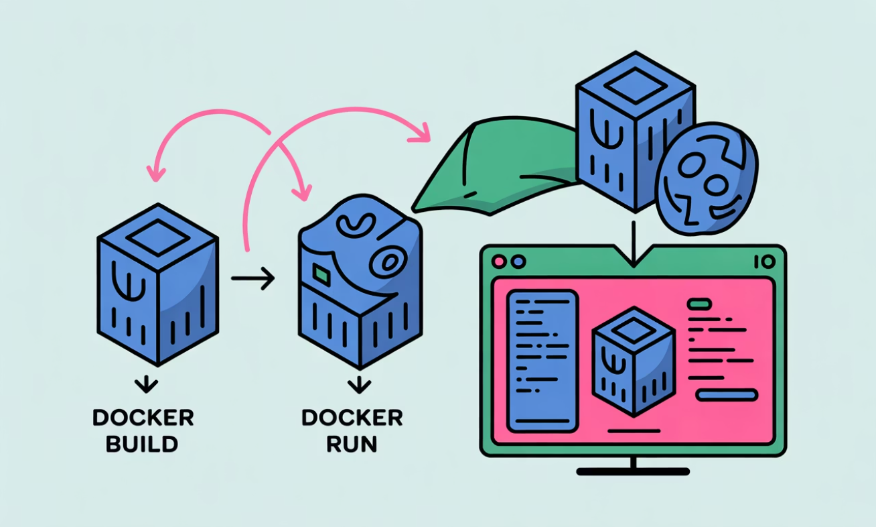
Docker Implementation: Containerised Efficiency
Dockerfile for Packaging
# Use an official OpenJDK runtime as a parent image
FROM openjdk:17-jdk-slim
# Add a volume pointing to /tmp
VOLUME /tmp
# Make port 8080 available to the world outside this container
EXPOSE 8080
# The application's jar file
ARG JAR_FILE=target/*.jar
# Add the application's jar to the container
ADD ${JAR_FILE} app.jar
# Run the jar file
ENTRYPOINT ["java","-jar","/app.jar"]
Key Commands
The Dockerfile meticulously defines the environment and steps required to package the Spring Boot application into a portable image.
docker build -t tilewarehouse .: Builds the Docker image from the Dockerfile.
docker run -p 8080:8080 tilewarehouse: Runs the container, mapping port 8080.
Benefits of Docker
Portability
Easy Deployment
Consistent Environment
Runs consistently across any environment with Docker installed.
Simplifies the deployment process, making rollouts faster and more reliable.
Eliminates "it works on my machine" issues by standardising the runtime.

Slide 9
Local Development Workflow
Our local development process is optimised for efficiency, allowing developers to work on both frontend and backend components seamlessly and test interactions in a controlled environment.
Backend Development
Frontend Development
The backend workflow focuses on building and containerising the Spring Boot application:
The frontend workflow ensures the React application can interact with the local backend:
mvn clean package: Compiles the Java code and packages it into a JAR file.
The generated JAR is located in the target folder, ready for Dockerisation.
A Docker image is then created and a container started to host the backend service.
npm install: Installs all necessary dependencies for the React project.
npm start: Launches the React development server.
The frontend is configured to connect to the backend at http://localhost:8080.

Slide 10


Future Enhancements & Conclusion
Future Enhancements
Database Migration
Transition from H2 to production-grade databases like MySQL or PostgreSQL.
Conclusion & Learnings
Cloud Deployment
This project has been a significant journey in full-stack development, culminating in a functional Tile Warehouse Management System.
Deploy the backend to cloud platforms for scalability and high availability.
Authentication & Authorisation
Implement robust security measures, including role-based access control.
Thank You!
CI/CD Integration
Any Questions?
Automate the build, test, and deployment process for faster releases.
Successful Development
Key Skill Acquisition
Deployment Expertise
Successfully delivered a comprehensive full-stack application.
Gained invaluable hands-on experience with React, Spring Boot, and Docker.
Enhanced understanding of real-world deployment workflows and best practices.

